Slide 1
Task-6 – Serverless: Cloud Function implementation
Name: Yanren Qu Course Name: TIES 4560 (2023)

Slide 2
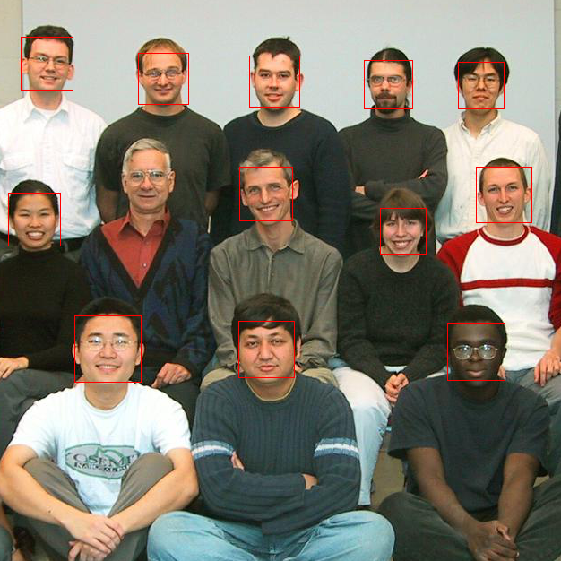
Project Description
In this task I use AWS Lambda to deploy a Face Detection Model API by creating AWS Api Gateway trigger.
This project aims to demonstrate the use of AWS Lambda and ONNX runtime for cloud-based deep learning inference.

Slide 3
AWS Services Used in my Project
AWS Lambda
Main python code of serverless inference, reducing infrastructure management complexities.
AWS EC2
Mainly used to debug code and download packages used in Lambda.
AWS S3
To store the code and model, Amazon S3 link URL imported by Lambda.

Slide 4
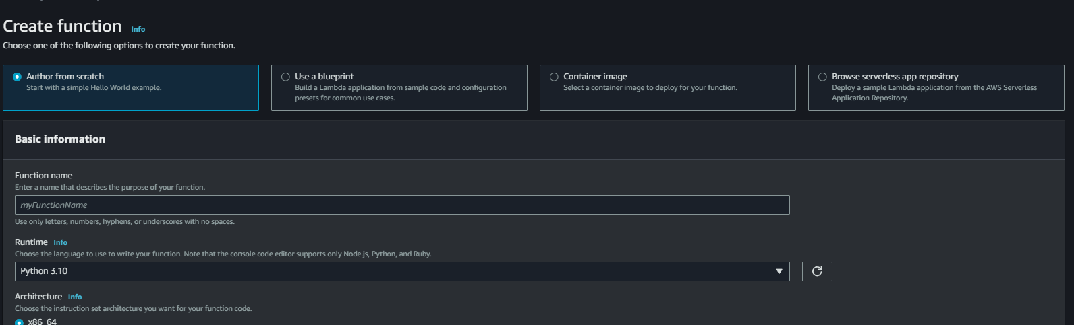
AWS Lambda
Click on "Create function" to start the function creation process.
Choose a function name, select a runtime (e.g., Python, Node.js), and configure permissions (role).
Click "Create function" to create the Lambda function.

Slide 5

Coding with Lambda
Basically, all you need to run a simple Lambda project is lambda_function.py and lambda_handler(event, context) Function.
However, in most cases, python project requires many packages.
Therefore you need to create a zip file of your project, which includes all required packages.
NOTICE: Our Lambda runs in x86_64 and machine, therefore your packages need to be compiled in this environment.

Slide 6

Coding with Lambda
To compile those packages, I create an Amazon EC2 instance uses Amazon Linux.
Create python 3.10 environment and download Git
git clone my python project repo.
Pip install somepackages –t .
Use this command to download packages into current folder.
Then zip whole directory and use scp to download to our windows machine.

Slide 7
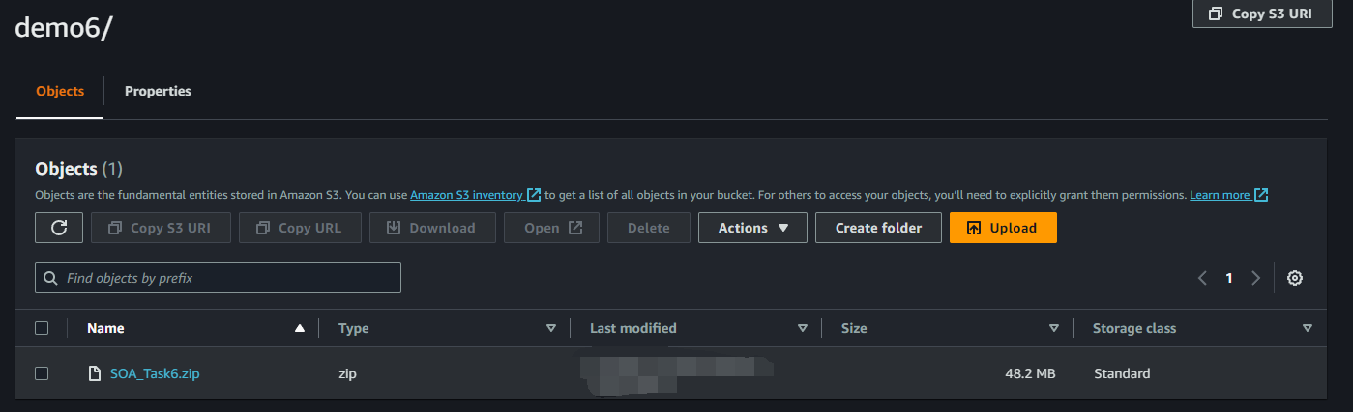
Coding with Lambda
Once we get the zip file with project code and packages, we can upload it to Lambda.
If your zip file is under 20mb, it is ok to upload it directly, however once it is over 20mb, Lambda recommend you to upload it to S3 bucket.
Then you can use S3 link URL to update your Lambda Code.

Slide 8
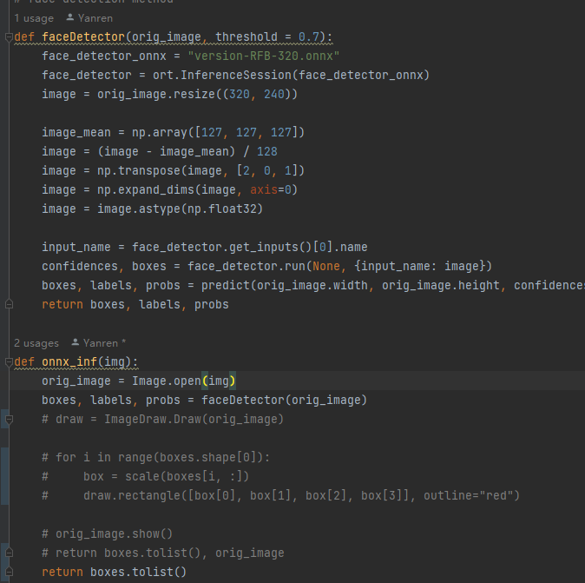
About Onnx and Face Detection
ONNX (Open Neural Network Exchange) is an open-source format and ecosystem designed to facilitate the interoperability of deep learning models and frameworks. It was developed to enable the seamless exchange of machine learning models between different frameworks and platforms. Here's a simple overview of ONNX
ONNX is framework-agnostic, which means it is not tied to any particular deep learning framework. It supports a wide range of popular frameworks like PyTorch, TensorFlow, and others。
ONNX models can be deployed and executed on a variety of platforms and devices, including desktop computers, cloud services, edge devices, and even IoT devices.

Slide 9
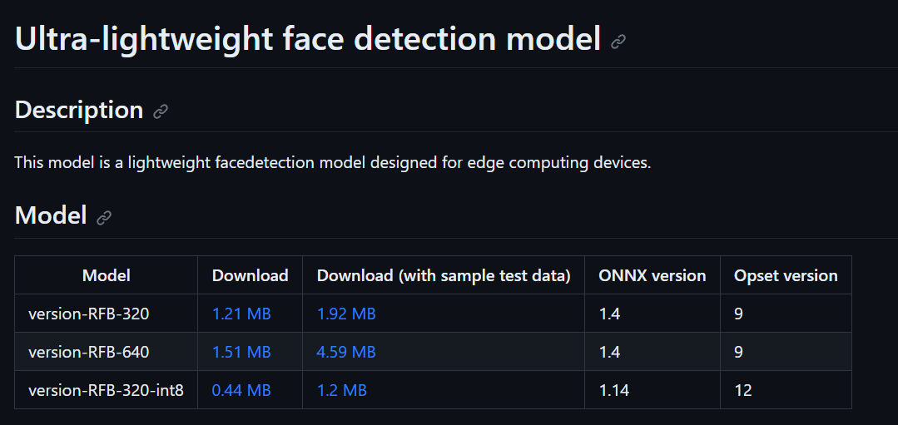
About Onnx and Face Detection
Face Detection model used in this project is UltraFace
version-RFB-320.
This model is super light weight, because our Lambda machine has very limited computing resource, this model is a good choice.
Sample code:
https://github.com/Linzaer/Ultra-Light-Fast-Generic-Face-Detector-1MB
https://github.com/onnx/models/blob/main/vision/body_analysis/ultraface/README.md#ultra-lightweight-face-detection-model

Slide 10
Logic of my Project
https://github.com/yanren1/SOA_Task6
First, use lambda_handler to get request from Api Gateway.
Our image should in base64 and stored in the json file.
Decode base64 image
Use PIL to read image, preprocess image.
Send numpy array format preprocessed image to onnx session.
Get outputs from model.
Do postprocess (NMS, anchors offset and decode)
Get final bounding boxes
Send boxes to json response.

